Slide 1
Reasoning in LLM Agents
CS598JY2 - Topics in LLM Agents
Allen Thomas, Kartik Ramesh, Shraddhaa Mohan

Slide 2
Chain-of-thought prompting elicits reasoning in Large Language Models

Slide 3
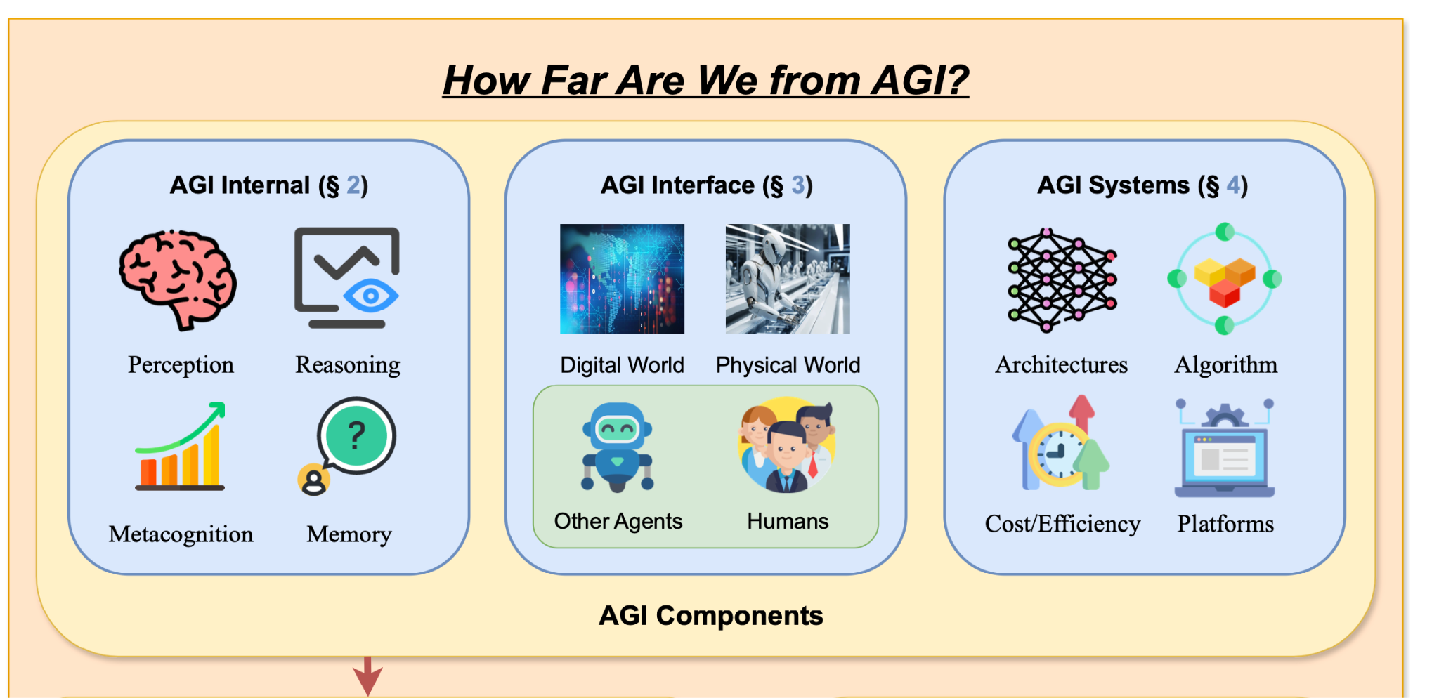
Reasoning and its importance
Reasoning: To think about something in a logical way
We want our agents to perceive information, draw logical conclusions and solve problems, ideally like a human would.
We want generalization, not memorization.

Slide 4
Can LLMs reason?
This movie sucks!
Sentiment = negative
Type 1
What football team is called the invincibles?
Arsenal
LLM
Notes:
LMs are pretty good at Type 1 tasks, these are tasks that are quick, intuitive and automatic and most humans could perform these sub-consciosuly.

Slide 5
Can LLMs reason?
This movie sucks!
Sentiment = negative
What football team is called the invincibles?
Arsenal
LLM
Concatenate the last letter of each word in this sentence “today was a good day”
yywsp
Type 2
The cafeteria had 23 apples, if they used 20 and bought 6 more, how many more do they have?
3
Notes:
LMs, in the one-shot setting, are not great at Type 2 tasks, these are tasks that require multi-step thinking. The example I’ve shown doesn’t work on GPT-4o either,
Just increasing model size does not improve performance.

Slide 6
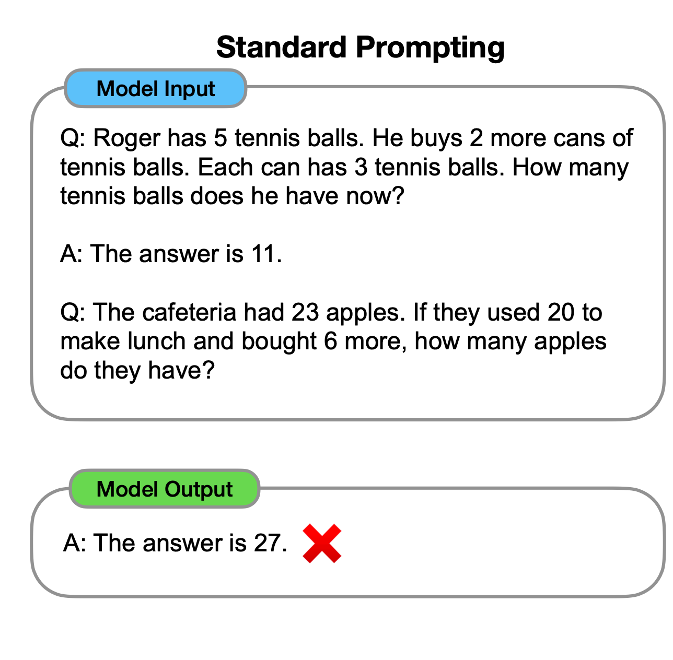
Using Chain Of Thought
Notes:
Since we want our agents to interact with the real world like humans do, a good approach would be to have them mimic
The way in which we solve problems, which is precisely the motivation for chain of thought. So on a complicated multi-step task, instead of asking the LLM to one-shot the task, we present it with examples where we suggest It to come up with a reasoning step.

Slide 7
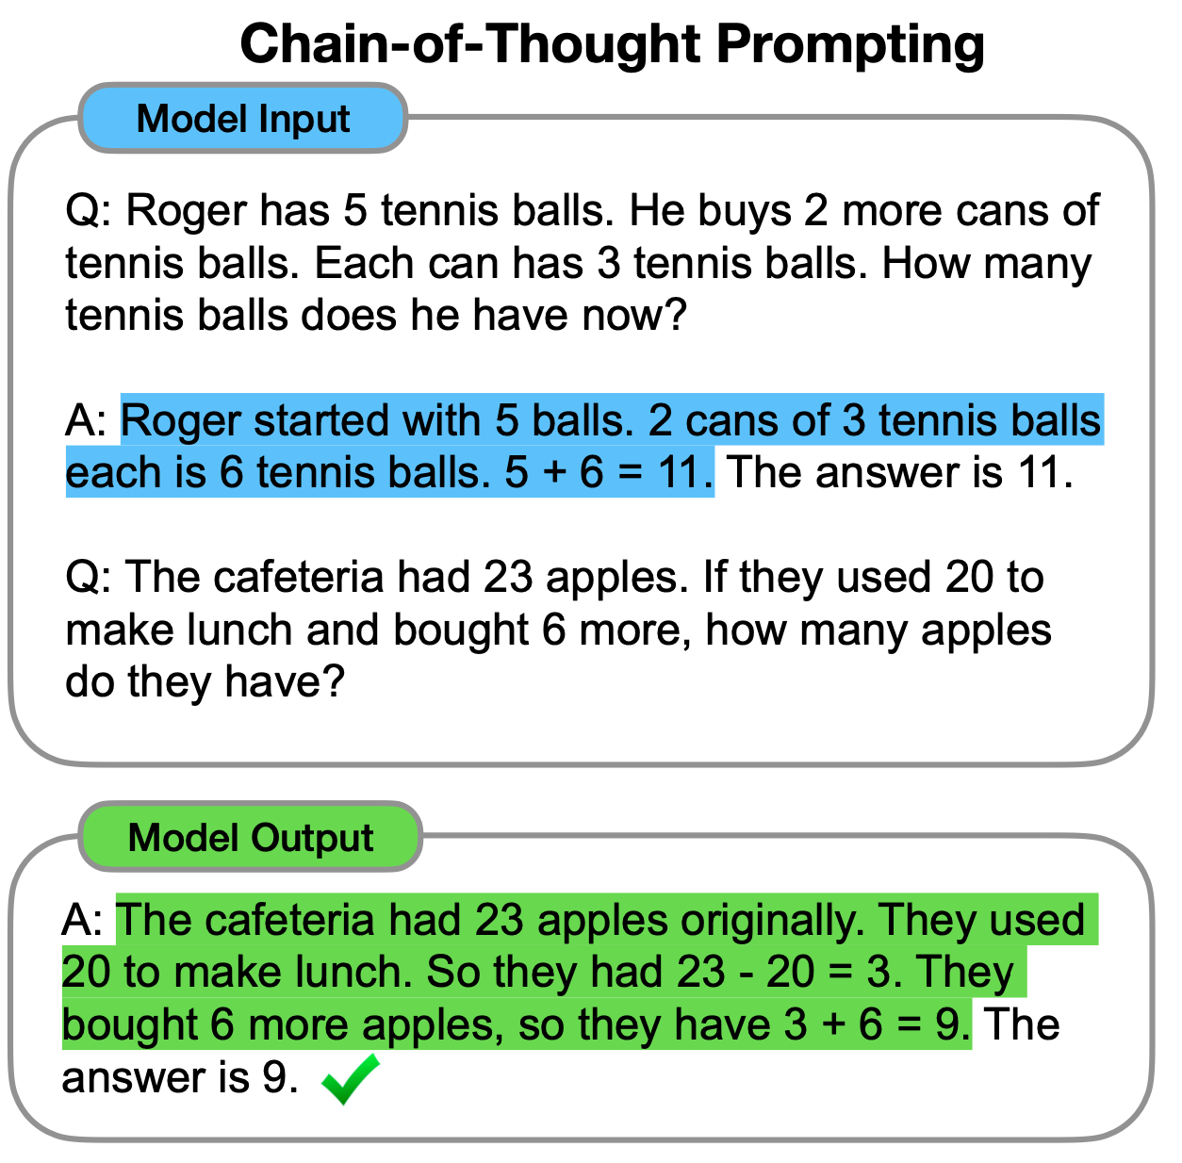
Using Chain Of Thought
Notes:
Since we want our agents to interact with the real world like humans do, a good approach would be to have them mimic
The way in which we solve problems, which is precisely the motivation for chain of thought.
So on a complicated multi-step problem, instead of asking the LLM to one-shot the task, we present it with examples where we suggest It to come up with a reasoning step.

Slide 8
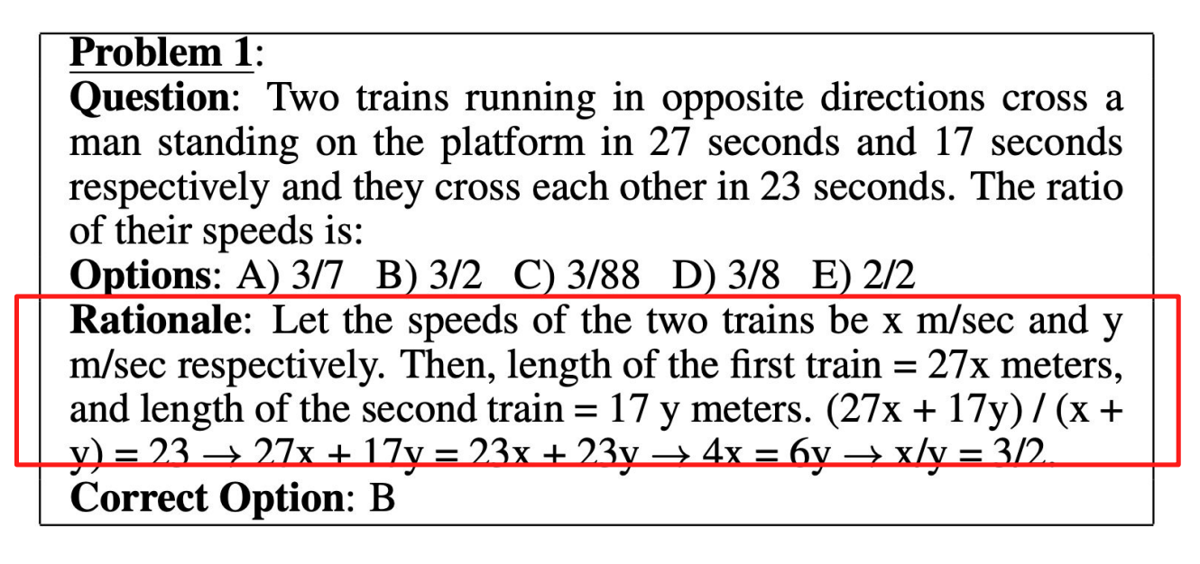
This isn’t new!
Using natural language models to generate rationale has been well researched. However, there were a few problems:
Generating a labelled data-set of problem, rationale, answer is hard.
You need to train a new model for each flavor of problem.
Source: Ling et. al Program Induction by Rationale Generation: Learning to Solve and Explain Algebraic Word Problems ACL 2017
Notes:
DeepMind was already working on this in 2017 (which is also the year when Transformers came out)
I don’t think I fully appreciated the impact of prompting before reading this paper. It’s kinda insane to just change the way you are phrasing your input, and suddenly
Your ML model can solve problems it was literally incapable of solving earlier.

Slide 9
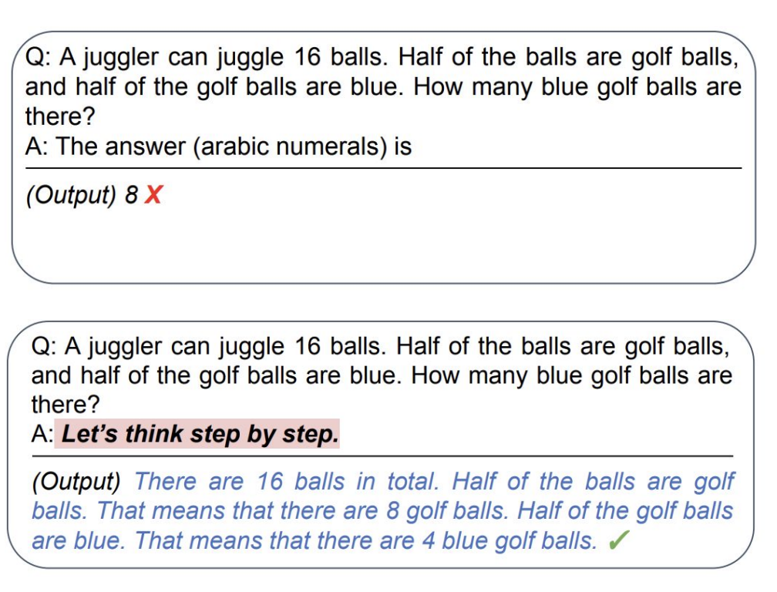
This isn’t new, but …
LLMs help solve this because they are:
Really good generalizers, even off a few examples.
We can achieve “fine-tuning” without actually re-training the model.
In fact, simply adding “let’s think step-by-step” is sufficient.
Source: Kojima, T., Gu, S.S., Reid, M., Matsuo, Y. and Iwasawa, Y. Large language models are zero-shot reasoners. NeurIPS 2022
Notes:
DeepMind was already working on this in 2017 (which is also the year when Transformers came out)
I don’t think I fully appreciated the impact of prompting before reading this paper. It’s kinda insane to just change the way you are phrasing your input, and suddenly
Your ML model can solve problems it was literally incapable of solving earlier.

Slide 10
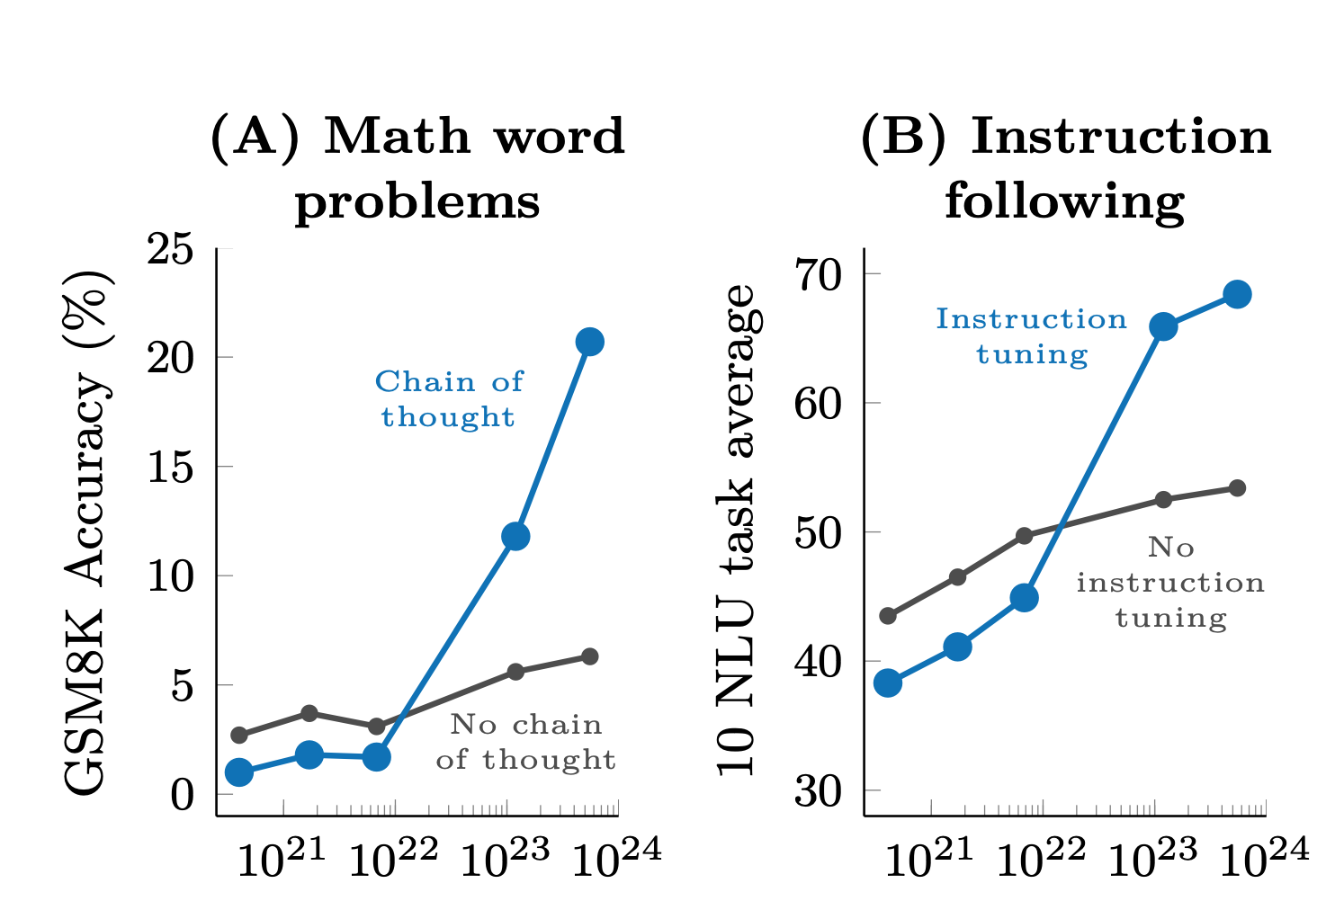
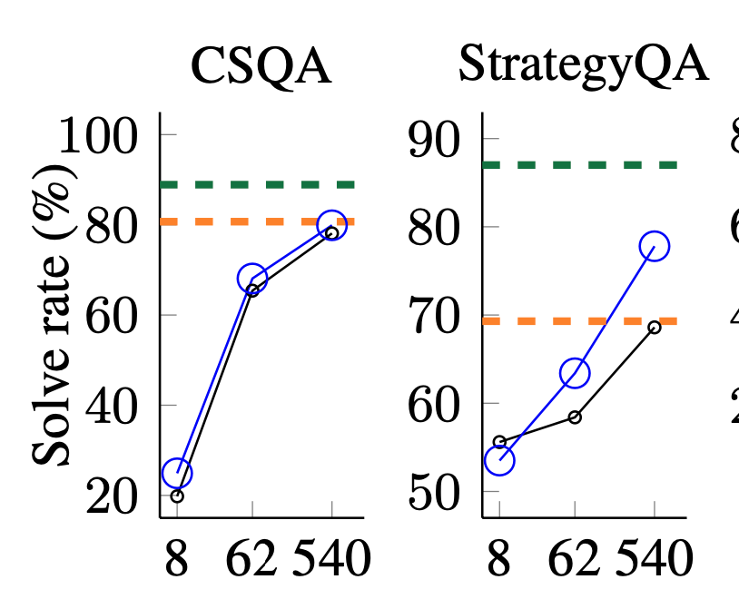
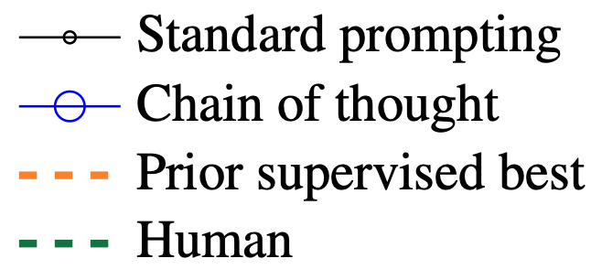
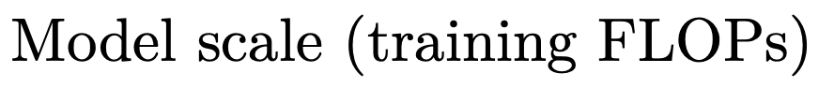
Results
Source: Kojima, T., Gu, S.S., Reid, M., Matsuo, Y. and Iwasawa, Y. Large language models are zero-shot reasoners. NeurIPS 2022
Notes:
CSQA is a commensense qa dataset. CoT increases performance a lot more on StrategyQA, which requires multistep reasoning.
In my opinion, what is a lot more interesting is the graph on the right. For type 2 problems such as math word problems, as we mentioned earlier,
Scaling model scale up, in terms of how much compute we have, doesn’t seem to help. We start to hit the limits of scaling laws.
However, with chain of thought, we unlock never seen before gains. At a certain model scale, CoT becomes really good. A likely explanation for
this is that at that scale, the model starts to generate a really good strategy for how to solve the problem.

Slide 11
Tree of Thought
Deliberate Problem Solving with Large Language Models.
Source: Shunyu Yao, Dian Yu, Jeffrey Zhao, Izhak Shafran, Thomas L. Griffiths, Yuan Cao, Karthik Narasimhan Tree of Thoughts: Deliberate Problem Solving with Large Language Models. NeurIPS 2023

Slide 12
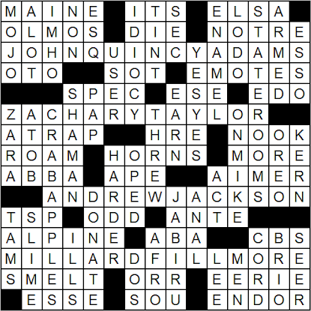
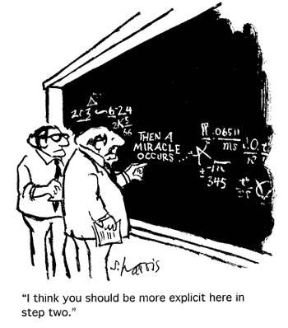
Key Challenges in LLM Reasoning
Think of problems like…
Traditional language models (LLMs) process problems sequentially, using left-to-right, token-level decision-making. This approach struggles with:
Tasks requiring exploration or strategic planning.
Situations where initial decisions significantly impact the final outcome.
Crosswords
Math Proofs
Source: Shunyu Yao, Dian Yu, Jeffrey Zhao, Izhak Shafran, Thomas L. Griffiths, Yuan Cao, Karthik Narasimhan Tree of Thoughts: Deliberate Problem Solving with Large Language Models. NeurIPS 2023

Slide 13
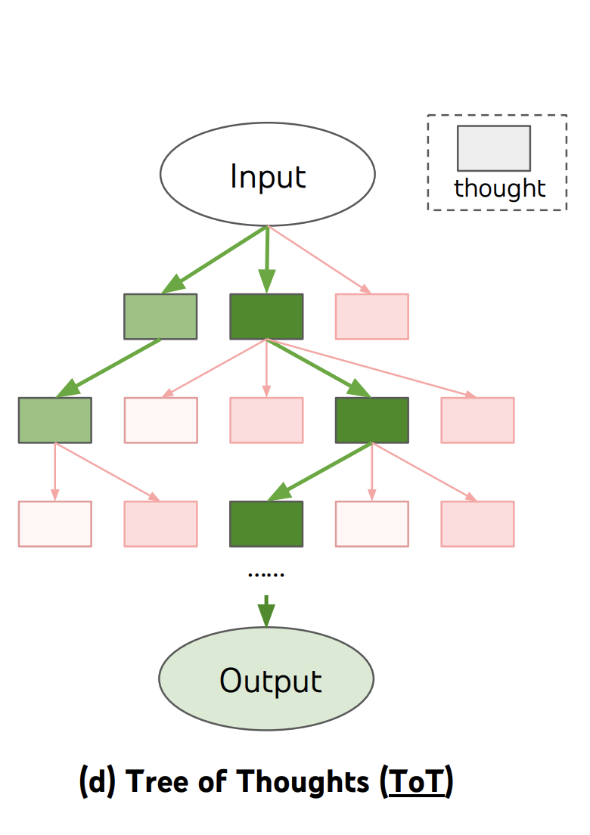
The Solution - Tree of Thoughts (ToT)
The Tree of Thoughts (ToT) framework addresses these limitations by enabling deliberate decision-making over multiple reasoning paths.
Goal: Enhance problem-solving by allowing LLMs to:
Explore diverse reasoning paths.
Self-evaluate intermediate steps.
Use lookahead and backtracking to refine solutions.
Source: Shunyu Yao, Dian Yu, Jeffrey Zhao, Izhak Shafran, Thomas L. Griffiths, Yuan Cao, Karthik Narasimhan Tree of Thoughts: Deliberate Problem Solving with Large Language Models. NeurIPS 2023

Slide 14
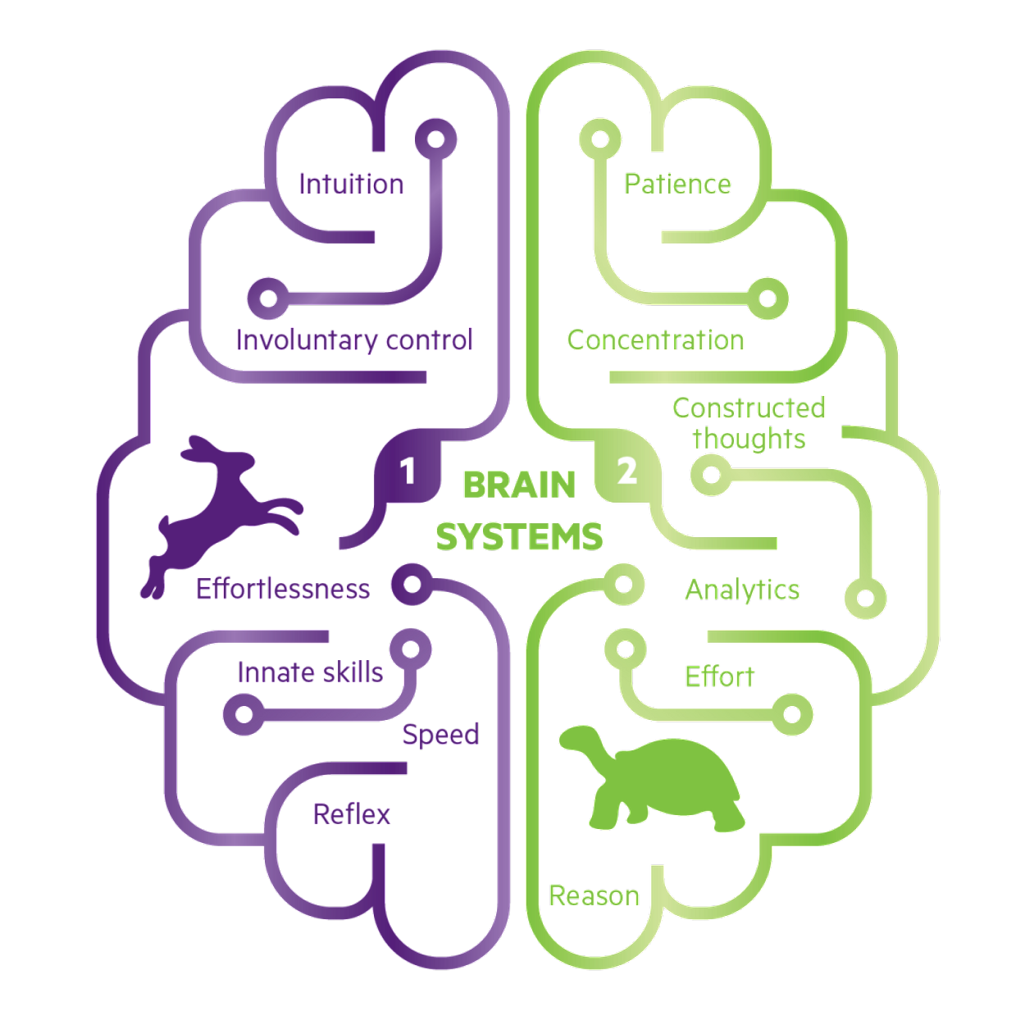
The Two Systems of Thought
ToT is inspired by human cognition literature, which talks about a “dual process” model for decision making. The two modes:
System 1: Fast, automatic, and intuitive thinking (e.g., instinctively reaching for a light switch in a dark room).
System 2: Slow, deliberate, and logical reasoning (e.g., solving a multi-step math problem).
ToT Focus: Mimics System 2 by encouraging deliberate, structured decision-making.
Source: Shunyu Yao, Dian Yu, Jeffrey Zhao, Izhak Shafran, Thomas L. Griffiths, Yuan Cao, Karthik Narasimhan Tree of Thoughts: Deliberate Problem Solving with Large Language Models. NeurIPS 2023
Notes:
The simple associative token-level choices of LMs are also reminiscent of “System 1”, “System 2” planning process that (1) maintains and explores diverse alternatives for current choices instead of just picking one, and (2) evaluates its current status and actively looks ahead or backtracks to make more global decisions.

Slide 15
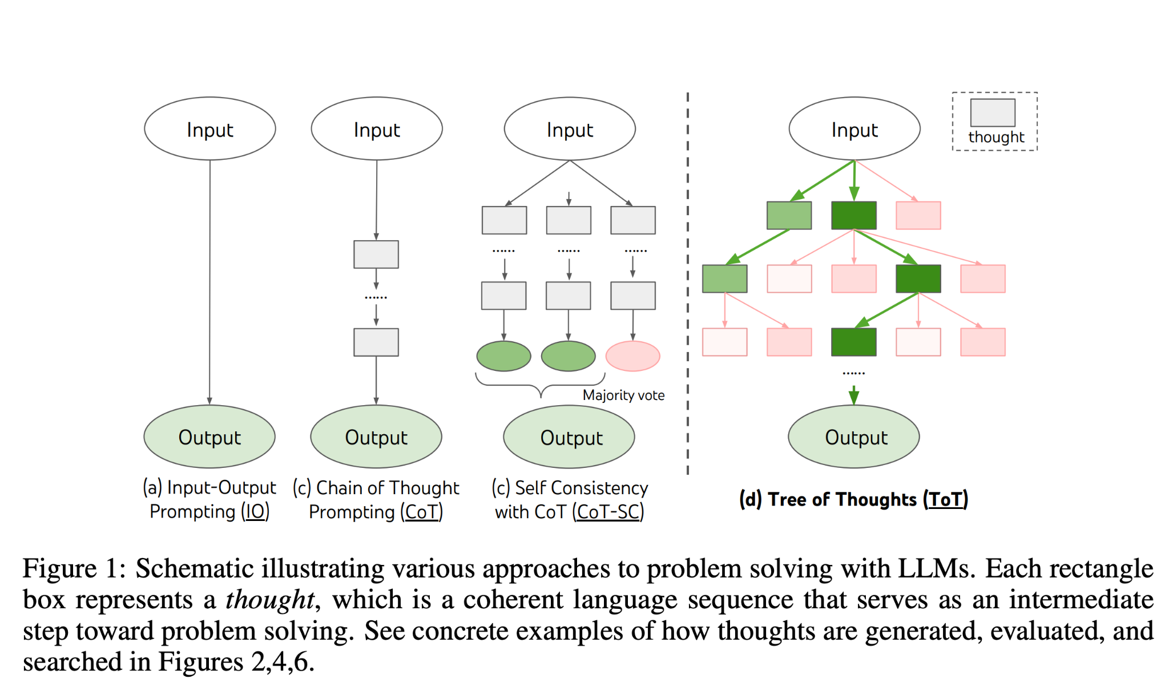
Existing Methods vs ToT
Source: Shunyu Yao, Dian Yu, Jeffrey Zhao, Izhak Shafran, Thomas L. Griffiths, Yuan Cao, Karthik Narasimhan Tree of Thoughts: Deliberate Problem Solving with Large Language Models. NeurIPS 2023
Notes:
Self-consistency with CoT (CoT-SC) [36] is an ensemble approach that samples k i.i.d. chains of thought: [z (i) 1···n , y(i) ] ∼ p CoT θ (z1···n, y|x) (i = 1 · · · k), then returns the most frequent output: arg maxy #{i | y (i) = y}. CoT-SC improves upon CoT, because there are generally different thought processes for the same problem (e.g. different ways to prove the same theorem), and the output decision can be more faithful by exploring a richer set of thoughts. However, within each chain there is no local exploration of different thought steps, and the “most frequent” heuristic only applies when the output space is limited (e.g. multi-choice QA) CoT focuses on linear reasoning; ToT introduces flexibility by exploring a tree-like structure.

Slide 16
Existing Methods - IO Prompting
How it works: The model produces a direct answer based on the input prompt without breaking down the reasoning process. It can also include some few-shot examples to guide the model's behavior.
Example Prompt: "What is 12 × 12?"
IO: "144."
Limitations:
Lacks intermediate reasoning steps, making it unsuitable for complex problems.
No transparency in how the answer was derived.
Source: Shunyu Yao, Dian Yu, Jeffrey Zhao, Izhak Shafran, Thomas L. Griffiths, Yuan Cao, Karthik Narasimhan Tree of Thoughts: Deliberate Problem Solving with Large Language Models. NeurIPS 2023

Slide 17
Existing Methods - Chain of Thought Prompting
How it works: Encourages the model to generate a linear sequence of intermediate steps before arriving at a final answer.
Example Prompt: "If John has 3 apples and buys 5 more, how many does he have?"
CoT: "John starts with 3 apples. He buys 5 more. Total = 3 + 5 = 8."
Advantages:
Improves performance on tasks requiring multi-step reasoning.
Limitations:
Follows a single reasoning path, which can lead to errors propagating through the chain.
No exploration of alternative solutions.
Source: Shunyu Yao, Dian Yu, Jeffrey Zhao, Izhak Shafran, Thomas L. Griffiths, Yuan Cao, Karthik Narasimhan Tree of Thoughts: Deliberate Problem Solving with Large Language Models. NeurIPS 2023

Slide 18
Existing Methods - Self Consistency with CoT
How it works: Generates multiple independent CoT chains and selects the most consistent result through majority voting.
Example Prompt: "If John has 3 apples and buys 5 more, how many does he have?"
CoT-SC: Chain 1: "John starts with 3 apples, buys 5 more → Total = 8."
Chain 2: "John has 3 apples, buys another set of 5 → Total = 8."
Chain 3: "John owns a basket of apples containing initially 3, adds in another batch of 5 → Total = 8."
Final Answer: Majority vote selects "8."
Advantages:
Reduces errors by leveraging multiple reasoning paths.
Limitations:
Chains are independent; no interaction or cross-validation between them.
“Most Frequent” heuristic only applies when the output space is limited (MCQs)
Source: Shunyu Yao, Dian Yu, Jeffrey Zhao, Izhak Shafran, Thomas L. Griffiths, Yuan Cao, Karthik Narasimhan Tree of Thoughts: Deliberate Problem Solving with Large Language Models. NeurIPS 2023

Slide 19
Tree of Thoughts Prompting
How it works: The Tree of Thought (ToT) framework enhances problem-solving by structuring reasoning as a search through a tree of thoughts.
Each node represents an intermediate thought/state that represents a partial solution, and branches represent alternative reasoning paths.
A specific instantiation of ToT involves answering four questions:
How to decompose the intermediate process into thought steps?
How to generate potential thoughts from each state?
How to heuristically evaluate states?
What search algorithm to use?
Source: Shunyu Yao, Dian Yu, Jeffrey Zhao, Izhak Shafran, Thomas L. Griffiths, Yuan Cao, Karthik Narasimhan Tree of Thoughts: Deliberate Problem Solving with Large Language Models. NeurIPS 2023

Slide 20


Tree of Thoughts Prompting - Thought Decomposition
How it works: While CoT samples thoughts coherently without explicit decomposition, ToT leverages problem properties to design and decompose intermediate thought steps.
There is a need to balance coherence and granularity when it comes to thought generation
LLM
Too Big to be coherent! ❌
Single Token is too small! ❌
Source: Shunyu Yao, Dian Yu, Jeffrey Zhao, Izhak Shafran, Thomas L. Griffiths, Yuan Cao, Karthik Narasimhan Tree of Thoughts: Deliberate Problem Solving with Large Language Models. NeurIPS 2023
Notes:
In general, a thought should be “small” enough so that LMs can generate promising and diverse samples (e.g. generating a whole book is usually too “big” to be coherent), yet “big” enough so that LMs can evaluate its prospect toward problem solving (e.g. generating one token is usually too “small” to evaluate).

Slide 21
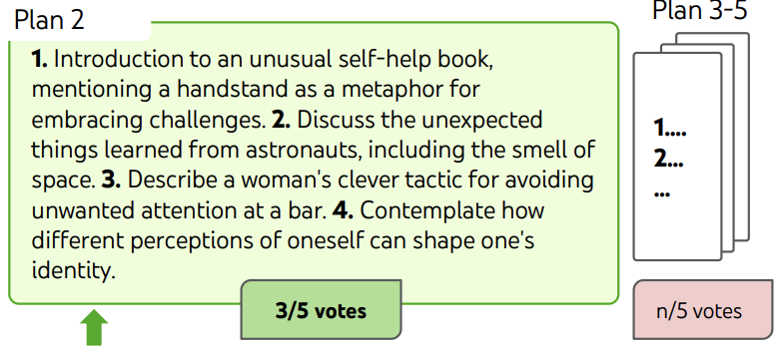
Tree of Thoughts Prompting - Thought Generation
How it works: Given a tree state, we consider two strategies to generate k candidates for the next thought step:
Independent Sampling:
Thoughts are sampled independently from a Chain of Thought (CoT) prompt.
Best for tasks with a rich thought space, where each thought is substantial (e.g., a paragraph in creative writing).
Sequential Proposals:
Thoughts are proposed sequentially using a "propose prompt."
Best for tasks with a constrained thought space, where each thought is small (e.g., a word puzzles).
Independent Sampling
Solved: h2.motor, h1.tasks
Used as letter constraints:
“v1.To heap: tm_ _ _”)
Sequential Prompt
Source: Shunyu Yao, Dian Yu, Jeffrey Zhao, Izhak Shafran, Thomas L. Griffiths, Yuan Cao, Karthik Narasimhan Tree of Thoughts: Deliberate Problem Solving with Large Language Models. NeurIPS 2023
Notes:
Independent Sampling Advantage: Promotes diversity by generating varied and creative ideas.
Independent CoT, In creative writing, each sampled thought could represent a unique paragraph direction.
Sequential Proposals:
Advantage:Reduces duplication by generating different thoughts in the same context.
Example: In the Game of 24, sequential proposals generate distinct operations 4+ 4* to explore multiple paths.

Slide 22
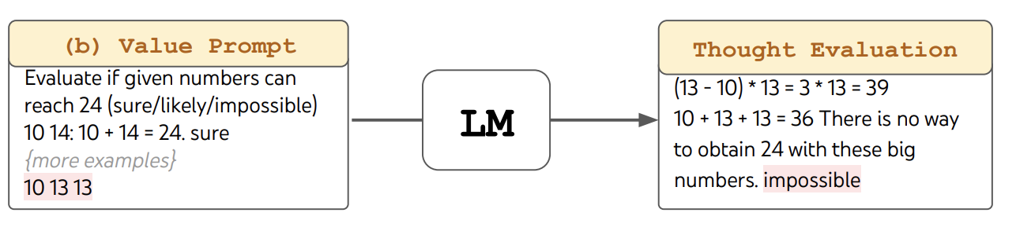
Tree of Thoughts Prompting - State Evaluation
How it works: Evaluate and rank candidate thoughts to prioritize promising paths. It serves as a heuristic for the search algorithm to determine which states to keep exploring and in which order. The LM deliberately reasons about states using self evaluation.
Evaluation Methods
Independent Evaluation: Each state is evaluated individually using a "value prompt”. Assigns a score or label (e.g., 1–10, or classifications like sure/likely/impossible). Combines:
Lookahead Simulations: Quickly check if a state can lead to a solution (e.g., confirm that 5 + 5 + 14 = 24 works).
Commonsense Filtering: Eliminate clearly invalid states (e.g., "1, 2, 3 are too small to reach 24").
Source: Shunyu Yao, Dian Yu, Jeffrey Zhao, Izhak Shafran, Thomas L. Griffiths, Yuan Cao, Karthik Narasimhan Tree of Thoughts: Deliberate Problem Solving with Large Language Models. NeurIPS 2023
Notes:
Independent Evaluation
Key Advantage: Promotes "good" states while discarding "bad" ones.

Slide 23
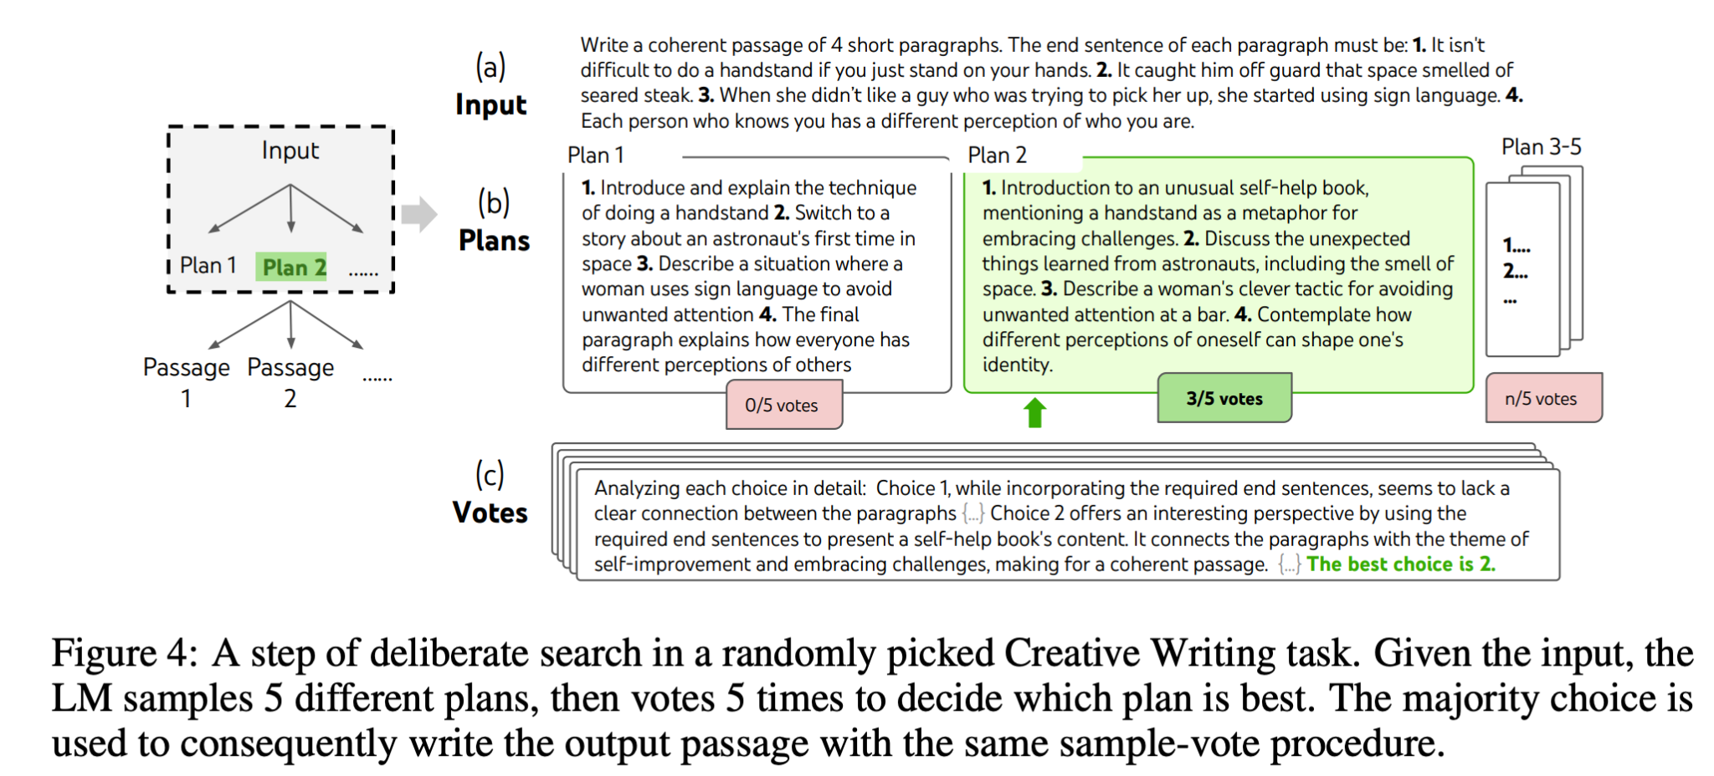
Tree of Thoughts Prompting - State Evaluation Cont..
Evaluation Methods Continued
Voting Across States: Compare all candidate states and vote for the most promising one. Uses a "vote prompt" to frame the decision as a multiple-choice question.
Best for tasks where direct evaluation is difficult (e.g., assessing passage coherence or creative writing).
Example: In creative writing, vote on which paragraph continuation best aligns with the narrative.
Source: Shunyu Yao, Dian Yu, Jeffrey Zhao, Izhak Shafran, Thomas L. Griffiths, Yuan Cao, Karthik Narasimhan Tree of Thoughts: Deliberate Problem Solving with Large Language Models. NeurIPS 2023
Notes:
Independent Evaluation
Key Advantage: Promotes "good" states while discarding "bad" ones.

Slide 24
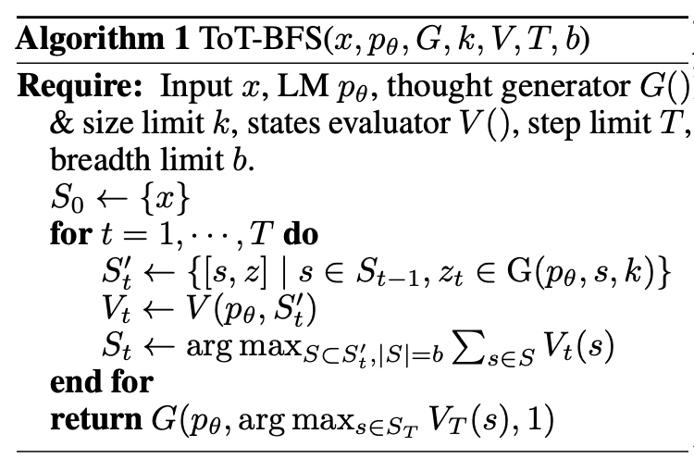
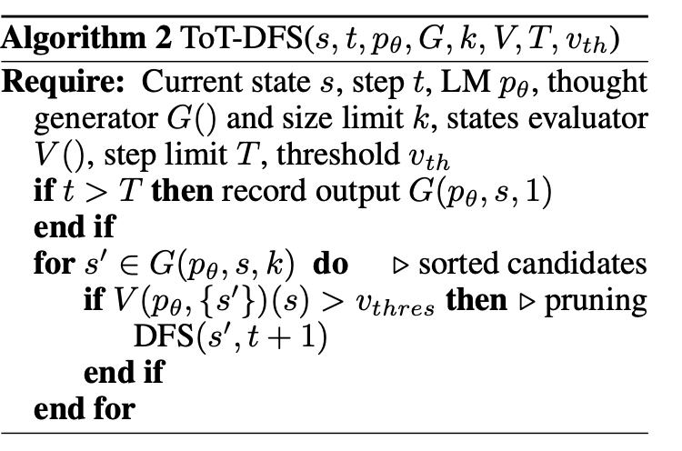
Tree of Thoughts Prompting - Search Algorithms
How it works: Navigate the tree of thoughts systematically to find optimal solutions.
Algorithms
Breadth-First Search (BFS): Explore all nodes at the current depth before moving deeper.
Ensures broad exploration but can be computationally expensive.
Depth-First Search (DFS): Explore one path deeply before backtracking to explore others.
Efficient for narrow trees but risks missing optimal solutions in wide trees
Source: Shunyu Yao, Dian Yu, Jeffrey Zhao, Izhak Shafran, Thomas L. Griffiths, Yuan Cao, Karthik Narasimhan Tree of Thoughts: Deliberate Problem Solving with Large Language Models. NeurIPS 2023

Slide 25
Advantages of ToT
Conceptually, ToT has several benefits as a method for general problem-solving with LMs:
Generality: IO, CoT, CoT-SC, and self-refinement can be seen as special cases of ToT (i.e. trees of limited depth and breadth)
Modularity:The base LM, as well as the thought decomposition, generation, evaluation, and search procedures can all be varied independently.
Adaptability: Different problem properties, LM capabilities, and resource constraints can be accommodated.
Convenience: No extra training is needed, just a pre-trained LM is sufficient.
Source: Shunyu Yao, Dian Yu, Jeffrey Zhao, Izhak Shafran, Thomas L. Griffiths, Yuan Cao, Karthik Narasimhan Tree of Thoughts: Deliberate Problem Solving with Large Language Models. NeurIPS 2023

Slide 26
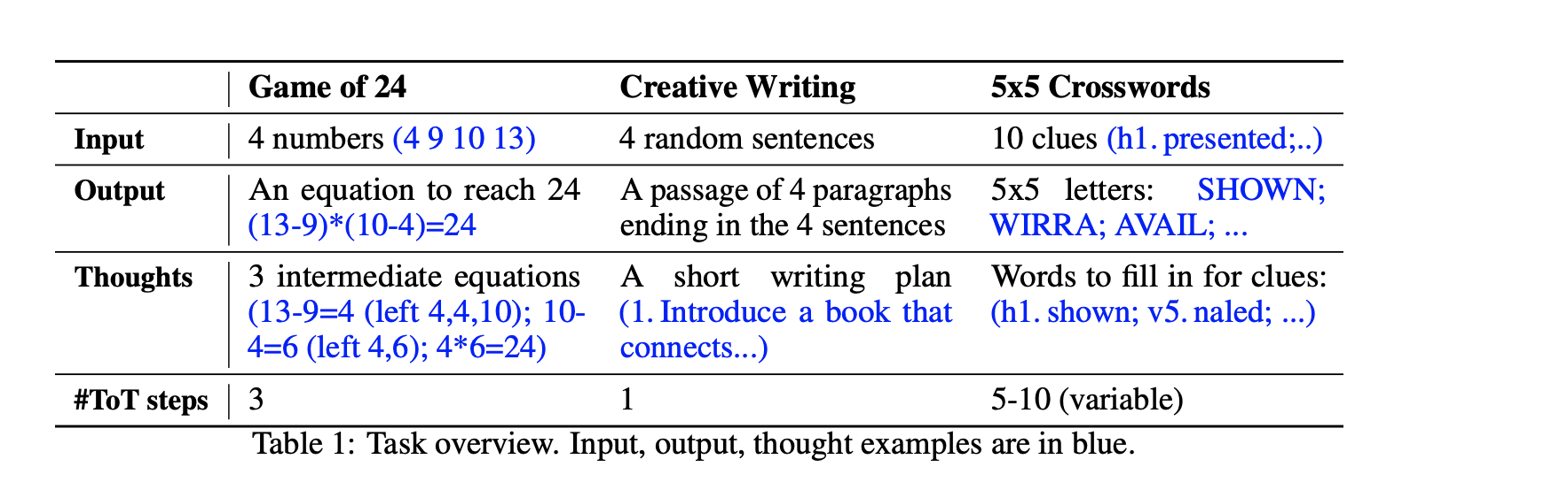
Experiments
The authors perform 3 experiments that aim to explore the limit of LM as a general problem solver that explores its own thoughts and guides its own exploration with deliberate reasoning as heuristics.
Source: Shunyu Yao, Dian Yu, Jeffrey Zhao, Izhak Shafran, Thomas L. Griffiths, Yuan Cao, Karthik Narasimhan Tree of Thoughts: Deliberate Problem Solving with Large Language Models. NeurIPS 2023

Slide 27
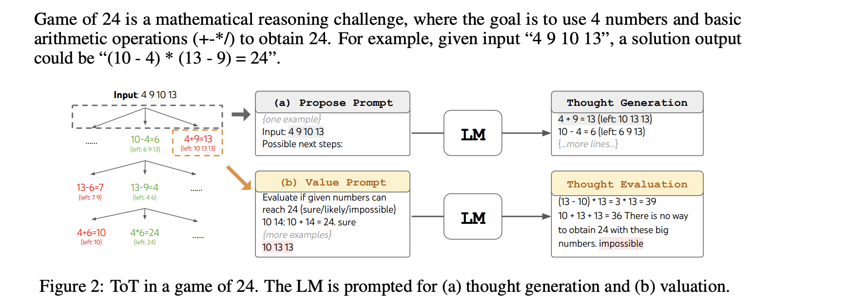
Game of 24
Lookahead
Source: Shunyu Yao, Dian Yu, Jeffrey Zhao, Izhak Shafran, Thomas L. Griffiths, Yuan Cao, Karthik Narasimhan Tree of Thoughts: Deliberate Problem Solving with Large Language Models. NeurIPS 2023
Notes:
Task: Use four numbers and basic operations (+, -, ×, ÷) to reach the target value of 24.
Success = Valid equation using all inputs exactly once to reach 24.
Variables:
k Number of thoughts generated at each step.
B Breadth limit of explored states at each level.
This uses BFS as well

Slide 28
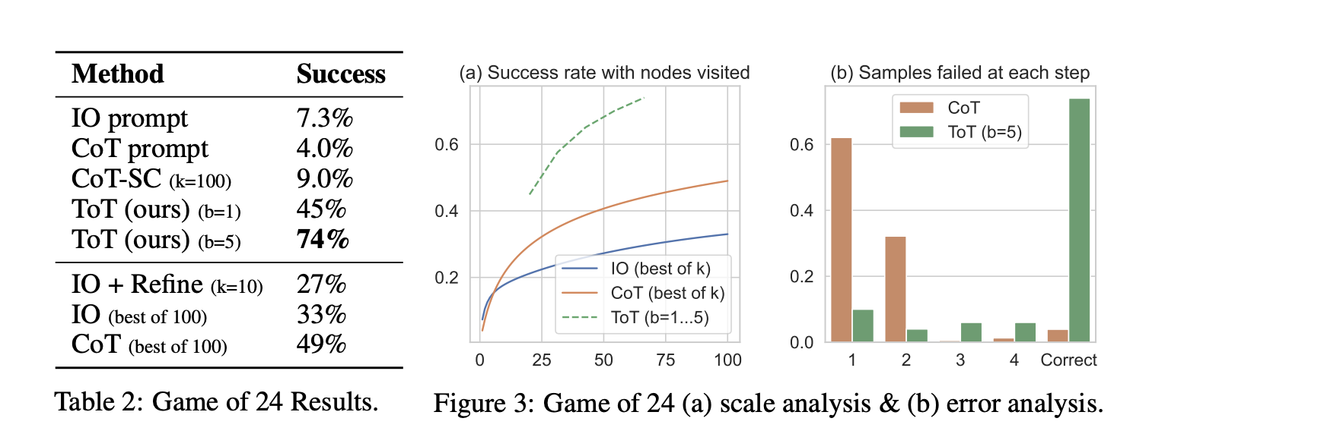
Game of 24: Results
Source: Shunyu Yao, Dian Yu, Jeffrey Zhao, Izhak Shafran, Thomas L. Griffiths, Yuan Cao, Karthik Narasimhan Tree of Thoughts: Deliberate Problem Solving with Large Language Models. NeurIPS 2023
Notes:
ToT (Breadth = 5): Achieved 74% success rate, significantly outperforming other methods.
Not surprisingly, CoT scales better than IO, and best of 100 CoT samples achieve a success rate of 49%, but still much worse than exploring more nodes in ToT (b > 1).
Key Insight: ToT's ability to explore multiple paths and evaluate thoughts systematically leads to superior performance.
. Figure 3(b) breaks down at which step CoT and ToT samples fail the task, i.e. the thought (in CoT) or all b thoughts (in ToT) are invalid or impossible to reach 24. Notably, around 60% of CoT samples already failed the task after generating the first step, or equivalently, the first three words (e.g. “4 + 9”). This highlights the issues with direct left-to-right decoding.

Slide 29
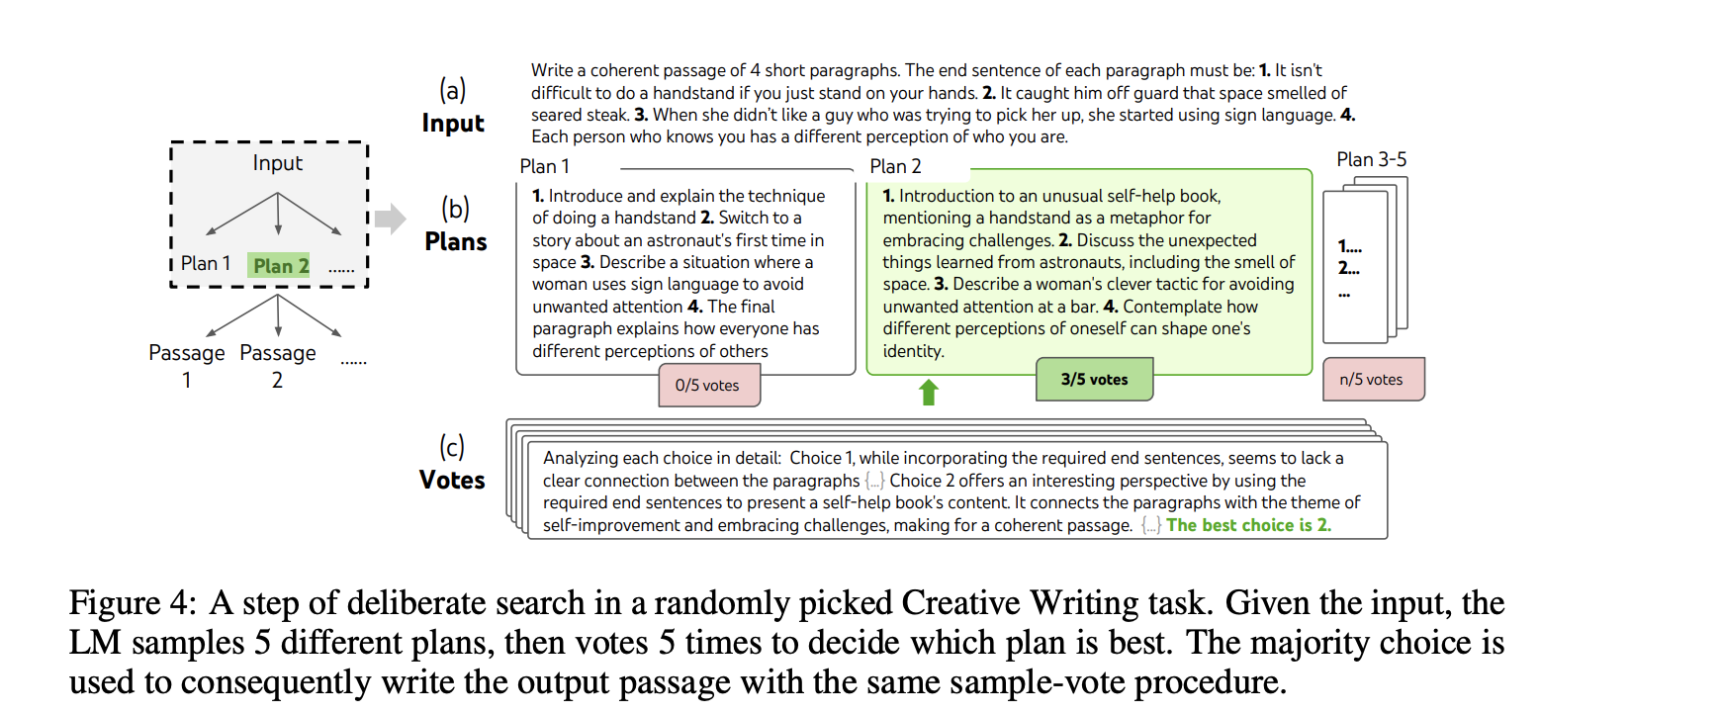
Creative Writing
Uses BFS
Source: Shunyu Yao, Dian Yu, Jeffrey Zhao, Izhak Shafran, Thomas L. Griffiths, Yuan Cao, Karthik Narasimhan Tree of Thoughts: Deliberate Problem Solving with Large Language Models. NeurIPS 2023
Notes:
creative writing task where the input is 4 random sentences and the output should be a coherent passage with 4 paragraphs that end in the 4 input sentences respectively

Slide 30
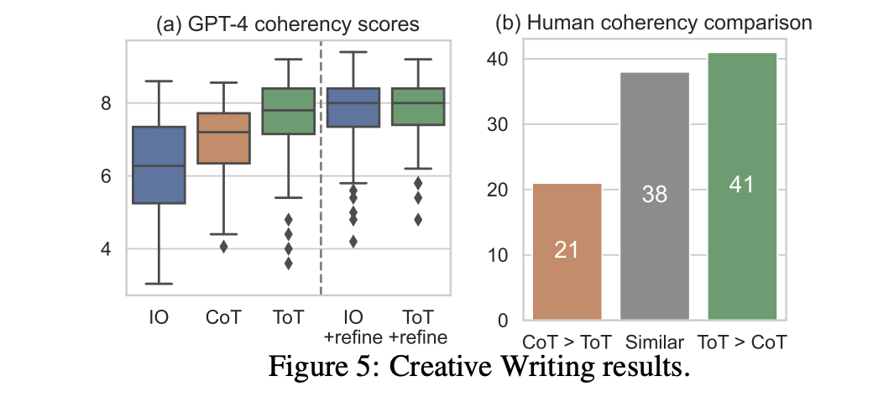
Creative Writing: Results
Passage coherency is evaluated in two ways:
using a GPT-4 zero-shot prompt to provide a 1-10 scalar score,
using human judgments to compare pairs of outputs from different methods.
IO Refine -> Improved performance: Potential for new thoughts to arise from refining old thoughts instead of i.i.d. or sequentially generated.
Source: Shunyu Yao, Dian Yu, Jeffrey Zhao, Izhak Shafran, Thomas L. Griffiths, Yuan Cao, Karthik Narasimhan Tree of Thoughts: Deliberate Problem Solving with Large Language Models. NeurIPS 2023
Notes:
Lastly, iterative-refine is more effective on this natural language task, where We believe it could be thought of as a third approach to thought generation in the ToT framework, where new thoughts can arise from refining old thoughts instead of i.i.d. or sequentially generated.

Slide 31
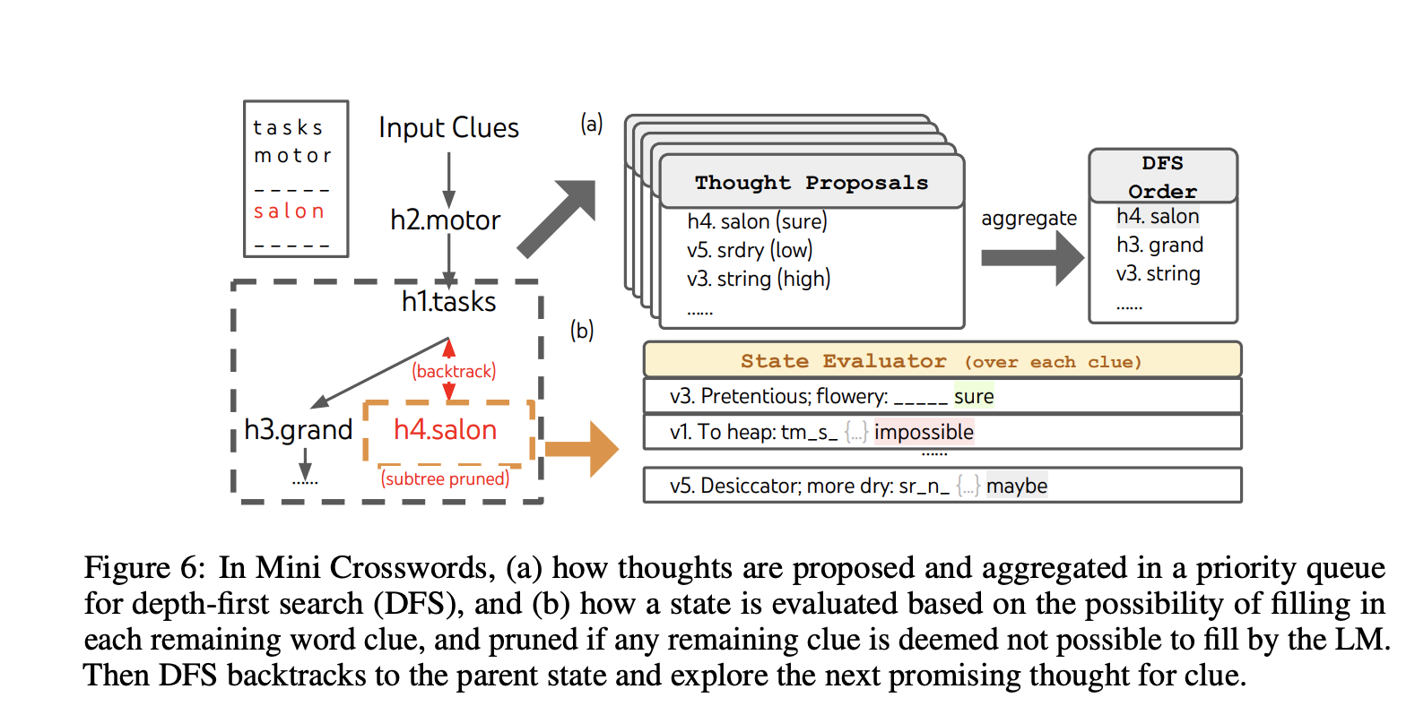
Mini Crosswords
Goal: Solve a 5x5 crossword puzzle using horizontal and vertical clues.
Source: Shunyu Yao, Dian Yu, Jeffrey Zhao, Izhak Shafran, Thomas L. Griffiths, Yuan Cao, Karthik Narasimhan Tree of Thoughts: Deliberate Problem Solving with Large Language Models. NeurIPS 2023
Notes:
For thought generation, at each state we translate all existing thoughts (e.g. “h2.motor; h1.tasks” for the state in Figure 6(a)) into letter constraints for remaining clues (e.g. “v1.To heap: tm ;...”)

Slide 32
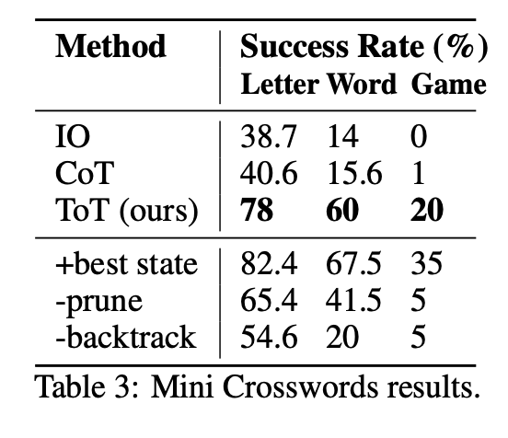
Mini Crosswords: Results
ToT clearly outperforms IO and CoT. Given IO
and CoT lack mechanisms to try different clues, make changes to decisions, or backtrack.
Takeaways:
Heuristic can be improved, using the oracle best DFS state per task, ToT performance is even higher and actually solves 7/20 games
Sometimes when the crosswords game is actually solved, the state evaluator might still deem some words as “impossible” and prune — possibly because 5 × 5 crosswords by design have some rare or obselete words that GPT-4 cannot recognize. (Eg: agend )
Pruning and Backtracking are beneficial
Source: Shunyu Yao, Dian Yu, Jeffrey Zhao, Izhak Shafran, Thomas L. Griffiths, Yuan Cao, Karthik Narasimhan Tree of Thoughts: Deliberate Problem Solving with Large Language Models. NeurIPS 2023
Notes:
2 For example, “agend” is an obsolete form of “agendum”, but GPT-4 deems it a typo for “agenda”. External retrieval or web interaction could augment LM for problem solving under knowledge uncertainty

Slide 33
Related Work
Planning and Decision-Making: Prior works leverage LMs for commonsense reasoning, but they focus on single path reasoning. Unlike reinforcement learning approaches (e.g., CHAI), which rely on dedicated reward and policy models, ToT uses the LM itself for value estimation.
Self Reflection: LLMs assess their own predictions to improve problem-solving accuracy, for example in feedback-based code generation. “Self-eval decoding” uses a tree-search process where leaves are generated via stochastic beam search and evaluated by the LLM using self-evaluation prompts. However, it relies on the PAL formulation, representing thoughts as code, which limits its ability to handle complex tasks like creative writing.
Source: Shunyu Yao, Dian Yu, Jeffrey Zhao, Izhak Shafran, Thomas L. Griffiths, Yuan Cao, Karthik Narasimhan Tree of Thoughts: Deliberate Problem Solving with Large Language Models. NeurIPS 2023
Notes:
with leaves sampled from stochastic beam search decoding,

Slide 34
Related Work
Program-Guided LLM Generation: Recent advancements organize LM behavior with systematic procedures or symbolic program guidance.
Schlag et al. embeds LMs in algorithmic search for step-by-step problem solving. They expands trees by sampling external paragraphs instead of LM-generated thoughts; lacks reflection or voting steps.
LLM+P: Delegates planning to classical planners rather than relying on LM-generated thought processes.
Classical Search Methods: ToT as a modern extension of classical search methods like A* where each search node's heuristic is provided by the LM’s self-assessment.
Source: Shunyu Yao, Dian Yu, Jeffrey Zhao, Izhak Shafran, Thomas L. Griffiths, Yuan Cao, Karthik Narasimhan Tree of Thoughts: Deliberate Problem Solving with Large Language Models. NeurIPS 2023
Notes:
with leaves sampled from stochastic beam search decoding,

Slide 35
Limitations And Future Work
Limitations:
Task Applicability: ToT may not be necessary for tasks where GPT-4 already performs well (simpler reasoning tasks).
Limited Experiments: Current experiments focus on only three relatively simple tasks challenging GPT-4.
Resource Intensity: ToT requires more computational resources compared to simpler sampling methods.
Off-the-Shelf LM Use: ToT uses pre-trained LMs without fine-tuning, potentially limiting optimization for specific tasks.
Future Work:
Complex Real-World Applications: Explore ToT for tasks like coding, data analysis, and robotics, where search and planning are critical.
Cost-Efficiency Tradeoffs: Modular flexibility of ToT allows customization to balance performance and cost.
Fine-Tuning LMs: Investigate fine-tuning LMs with ToT-style decision-making to enhance problem-solving capabilities.
Source: Shunyu Yao, Dian Yu, Jeffrey Zhao, Izhak Shafran, Thomas L. Griffiths, Yuan Cao, Karthik Narasimhan Tree of Thoughts: Deliberate Problem Solving with Large Language Models. NeurIPS 2023

Slide 36
ReAct
Interleaving Reasoning and Acting in Language Models

Slide 37
Key Idea
Motivation: LLMs excel at reasoning (CoT) and acting (action generation), but they are typically studied separately -
Key Idea: ReAct interleaves reasoning traces and actions to enhance task-solving capabilities.
React: Synergizing Reasoning And Acting In Language Models Shunyu Yao, Jeffrey Zhao , Dian Yu, Nan Du, Izhak Shafran, Karthik Narasimhan, Yuan Cao - Department of Computer Science, Princeton

Slide 38
Human-Like Reasoning & Acting
Example: Cooking – humans reason (“I need to heat water”) and act (“turn on the stove”).
Goal: Enable LLMs to reason dynamically while interacting with environments.
React: Synergizing Reasoning And Acting In Language Models Shunyu Yao, Jeffrey Zhao , Dian Yu, Nan Du, Izhak Shafran, Karthik Narasimhan, Yuan Cao - Department of Computer Science, Princeton

Slide 39
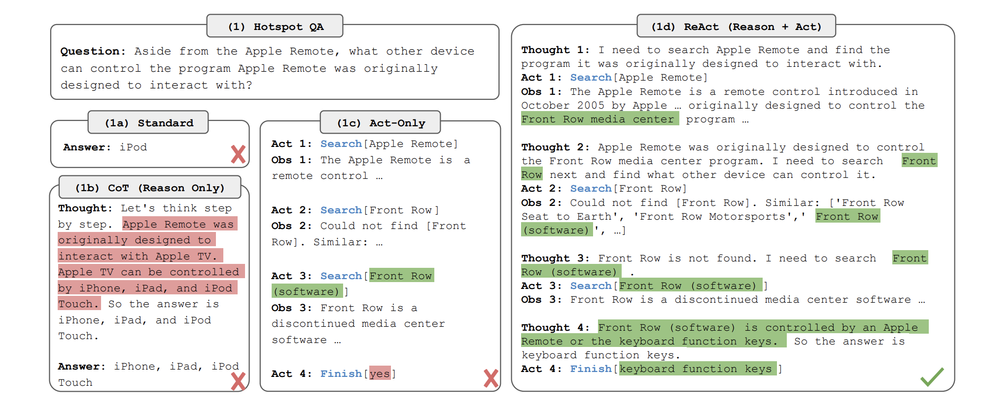
Human-Like Reasoning & Acting
Standard prompting: Direct answers without reasoning.
Chain-of-Thought (CoT): Reasoning without external actions.
Act-only: Actions without structured reasoning.
ReAct (Paper): Combines both for synergy.
React: Synergizing Reasoning And Acting In Language Models Shunyu Yao, Jeffrey Zhao , Dian Yu, Nan Du, Izhak Shafran, Karthik Narasimhan, Yuan Cao - Department of Computer Science, Princeton

Slide 40
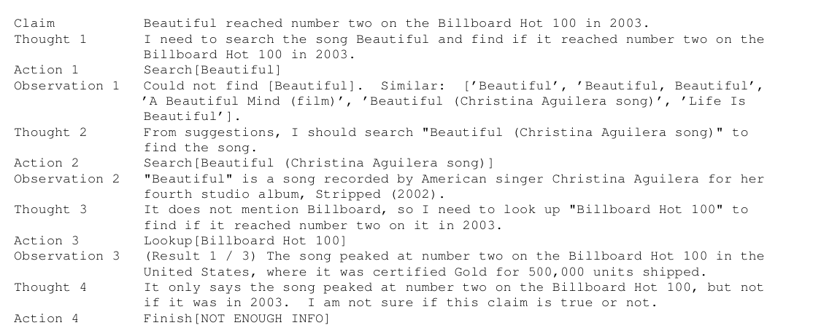
What this looks like -
React: Synergizing Reasoning And Acting In Language Models Shunyu Yao, Jeffrey Zhao , Dian Yu, Nan Du, Izhak Shafran, Karthik Narasimhan, Yuan Cao - Department of Computer Science, Princeton

Slide 41
Implementation
Few-Shot Prompting Approach
Base Model: PaLM-540B
Provided a few in-context examples with structured thought-action-observation sequences.
Model learns to think before acting, track progress, and adjust plans dynamically.
Limitation: Prompting alone struggles with long-horizon tasks.
React: Synergizing Reasoning And Acting In Language Models Shunyu Yao, Jeffrey Zhao , Dian Yu, Nan Du, Izhak Shafran, Karthik Narasimhan, Yuan Cao - Department of Computer Science, Princeton

Slide 42
Implementation
Finetuning for Improved Performance
Solution: Generate 3,000 ReAct trajectories using few-shot prompting and use them for training.
Training Process:
Generate structured thought-action-observation data.
Fine-tune smaller models (PaLM-8B, PaLM-62B).
Models learn when to think, when to act, and how to correct mistakes.
React: Synergizing Reasoning And Acting In Language Models Shunyu Yao, Jeffrey Zhao , Dian Yu, Nan Du, Izhak Shafran, Karthik Narasimhan, Yuan Cao - Department of Computer Science, Princeton

Slide 43
Benchmarks Evaluated
HotPotQA (Question Answering)
Fever (Fact Verification)
ALFWorld (Text-Based Game)
WebShop (Webpage Navigation)
React: Synergizing Reasoning And Acting In Language Models Shunyu Yao, Jeffrey Zhao , Dian Yu, Nan Du, Izhak Shafran, Karthik Narasimhan, Yuan Cao - Department of Computer Science, Princeton

Slide 44
Knowledge Intensive Reasoning Tasks
HotPotQA (Question Answering) - a multi-hop question answering benchmark that requires reasoning over two or more Wikipedia passages
Fever (Fact Verification) - a fact verification benchmark where each claim is annotated SUPPORTS, REFUTES, or NOT ENOUGH INFO, based on if there exists a Wikipedia passage to verify the claim
React: Synergizing Reasoning And Acting In Language Models Shunyu Yao, Jeffrey Zhao , Dian Yu, Nan Du, Izhak Shafran, Karthik Narasimhan, Yuan Cao - Department of Computer Science, Princeton

Slide 45
Action Space
Design of Wikipedia Web API with 3 Actions:
Search[entity]:
Retrieves first 5 sentences from an entity’s Wikipedia page or suggests top-5 similar entities if not found.
Lookup[string]:
Simulates browser's Ctrl+F functionality, returning the next sentence containing the given string in a page.
Finish[answer]:
Completes the task with the final answer.
React: Synergizing Reasoning And Acting In Language Models Shunyu Yao, Jeffrey Zhao , Dian Yu, Nan Du, Izhak Shafran, Karthik Narasimhan, Yuan Cao - Department of Computer Science, Princeton

Slide 46
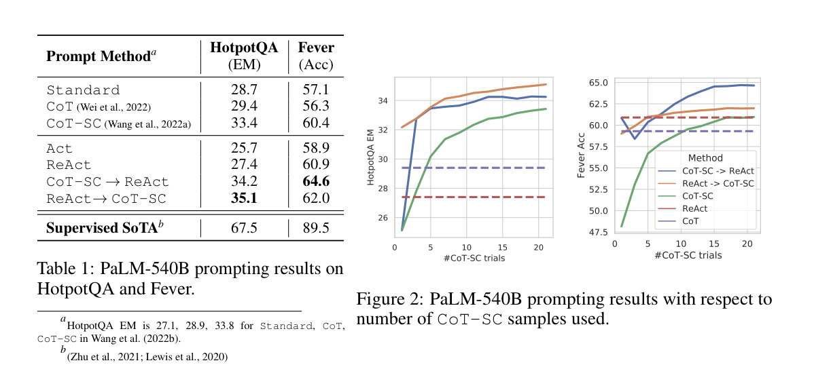
Key Results
React: Synergizing Reasoning And Acting In Language Models Shunyu Yao, Jeffrey Zhao , Dian Yu, Nan Du, Izhak Shafran, Karthik Narasimhan, Yuan Cao - Department of Computer Science, Princeton
Notes:
We systematically ablate ReAct trajectories to build prompts for multiple baselines (with formats as Figure 1(1a-1c)): (a) Standard prompting (Standard), which removes all thoughts, actions, observations in ReAct trajectories.
(b) Chain-of-thought prompting (CoT) (Wei et al., 2022), which removes actions and observations and serve as a reasoning-only baseline. We also build a self-consistency baseline (CoT-SC) (Wang et al., 2022a;b) by sampling 21 CoT trajectories with decoding temperature 0.7 during inference and adopting the majority answer, which is found to consistently boost performance over CoT.
(c) Acting-only prompt (Act), which removes thoughts in ReAct trajectories, loosely resembling how WebGPT (Nakano et al., 2021) interacts with the Internet to answer questions, though it operates on a different task and action space, and uses imitation and reinforcement learning instead of prompting.

Slide 47
Key Findings
HotPotQA & Fever: ReAct outperforms vanilla action generation models and is competitive with Chain-of-Thought (CoT) reasoning.
Best Approach: Combination of ReAct and CoT enables use of internal knowledge and externally obtained information during reasoning.
React: Synergizing Reasoning And Acting In Language Models Shunyu Yao, Jeffrey Zhao , Dian Yu, Nan Du, Izhak Shafran, Karthik Narasimhan, Yuan Cao - Department of Computer Science, Princeton

Slide 48
ReAct v/s CoT Behavioral Differences
Hallucination: CoT struggles with hallucination, leading to more false positives.
Grounded & Trustworthy Reasoning: ReAct, aided by external knowledge, offers more reliable reasoning traces.
Flexibility Trade-Off: The structured nature of ReAct limits flexibility in reasoning steps, causing more errors in some cases.
React: Synergizing Reasoning And Acting In Language Models Shunyu Yao, Jeffrey Zhao , Dian Yu, Nan Du, Izhak Shafran, Karthik Narasimhan, Yuan Cao - Department of Computer Science, Princeton
Notes:
We systematically ablate ReAct trajectories to build prompts for multiple baselines (with formats as Figure 1(1a-1c)): (a) Standard prompting (Standard), which removes all thoughts, actions, observations in ReAct trajectories.
(b) Chain-of-thought prompting (CoT) (Wei et al., 2022), which removes actions and observations and serve as a reasoning-only baseline. We also build a self-consistency baseline (CoT-SC) (Wang et al., 2022a;b) by sampling 21 CoT trajectories with decoding temperature 0.7 during inference and adopting the majority answer, which is found to consistently boost performance over CoT.
(c) Acting-only prompt (Act), which removes thoughts in ReAct trajectories, loosely resembling how WebGPT (Nakano et al., 2021) interacts with the Internet to answer questions, though it operates on a different task and action space, and uses imitation and reinforcement learning instead of prompting.

Slide 49
Finetuning with ReAct
ReAct, when fine-tuned, significantly outperforms all prompting methods (Standard, CoT, Act) on HotPotQA.
PaLM-8B fine-tuned ReAct outperforms PaLM-62B prompting methods.
Key Advantage: Fine-tuning allows ReAct to effectively generalize for knowledge reasoning tasks, outperforming other methods that focus on memorization.
React: Synergizing Reasoning And Acting In Language Models Shunyu Yao, Jeffrey Zhao , Dian Yu, Nan Du, Izhak Shafran, Karthik Narasimhan, Yuan Cao - Department of Computer Science, Princeton
Notes:
We systematically ablate ReAct trajectories to build prompts for multiple baselines (with formats as Figure 1(1a-1c)): (a) Standard prompting (Standard), which removes all thoughts, actions, observations in ReAct trajectories.
(b) Chain-of-thought prompting (CoT) (Wei et al., 2022), which removes actions and observations and serve as a reasoning-only baseline. We also build a self-consistency baseline (CoT-SC) (Wang et al., 2022a;b) by sampling 21 CoT trajectories with decoding temperature 0.7 during inference and adopting the majority answer, which is found to consistently boost performance over CoT.
(c) Acting-only prompt (Act), which removes thoughts in ReAct trajectories, loosely resembling how WebGPT (Nakano et al., 2021) interacts with the Internet to answer questions, though it operates on a different task and action space, and uses imitation and reinforcement learning instead of prompting.

Slide 50
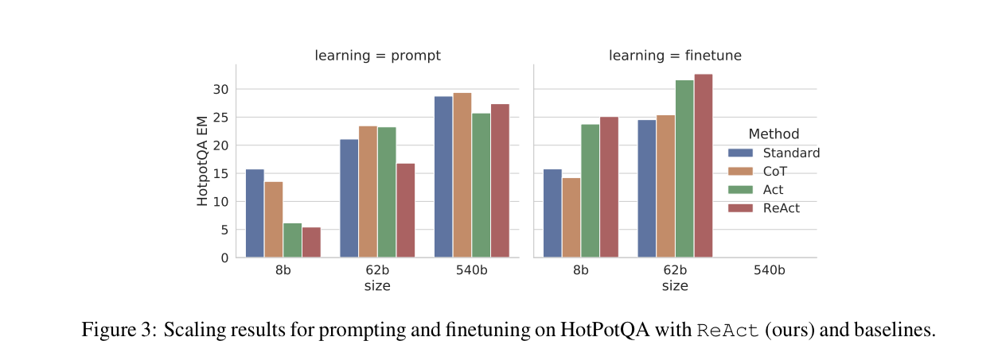
Key Results
React: Synergizing Reasoning And Acting In Language Models Shunyu Yao, Jeffrey Zhao , Dian Yu, Nan Du, Izhak Shafran, Karthik Narasimhan, Yuan Cao - Department of Computer Science, Princeton

Slide 51
Decision Making Benchmarks
1. ALFWorld
Task: Agents must achieve high-level goals in a household
2. WebShop: Interactive Web Shopping Task
Task: Purchase a product (e.g., "nightstand with drawers, priced under $140") through interactions on a shopping website with structured and unstructured texts.
React: Synergizing Reasoning And Acting In Language Models Shunyu Yao, Jeffrey Zhao , Dian Yu, Nan Du, Izhak Shafran, Karthik Narasimhan, Yuan Cao - Department of Computer Science, Princeton

Slide 52
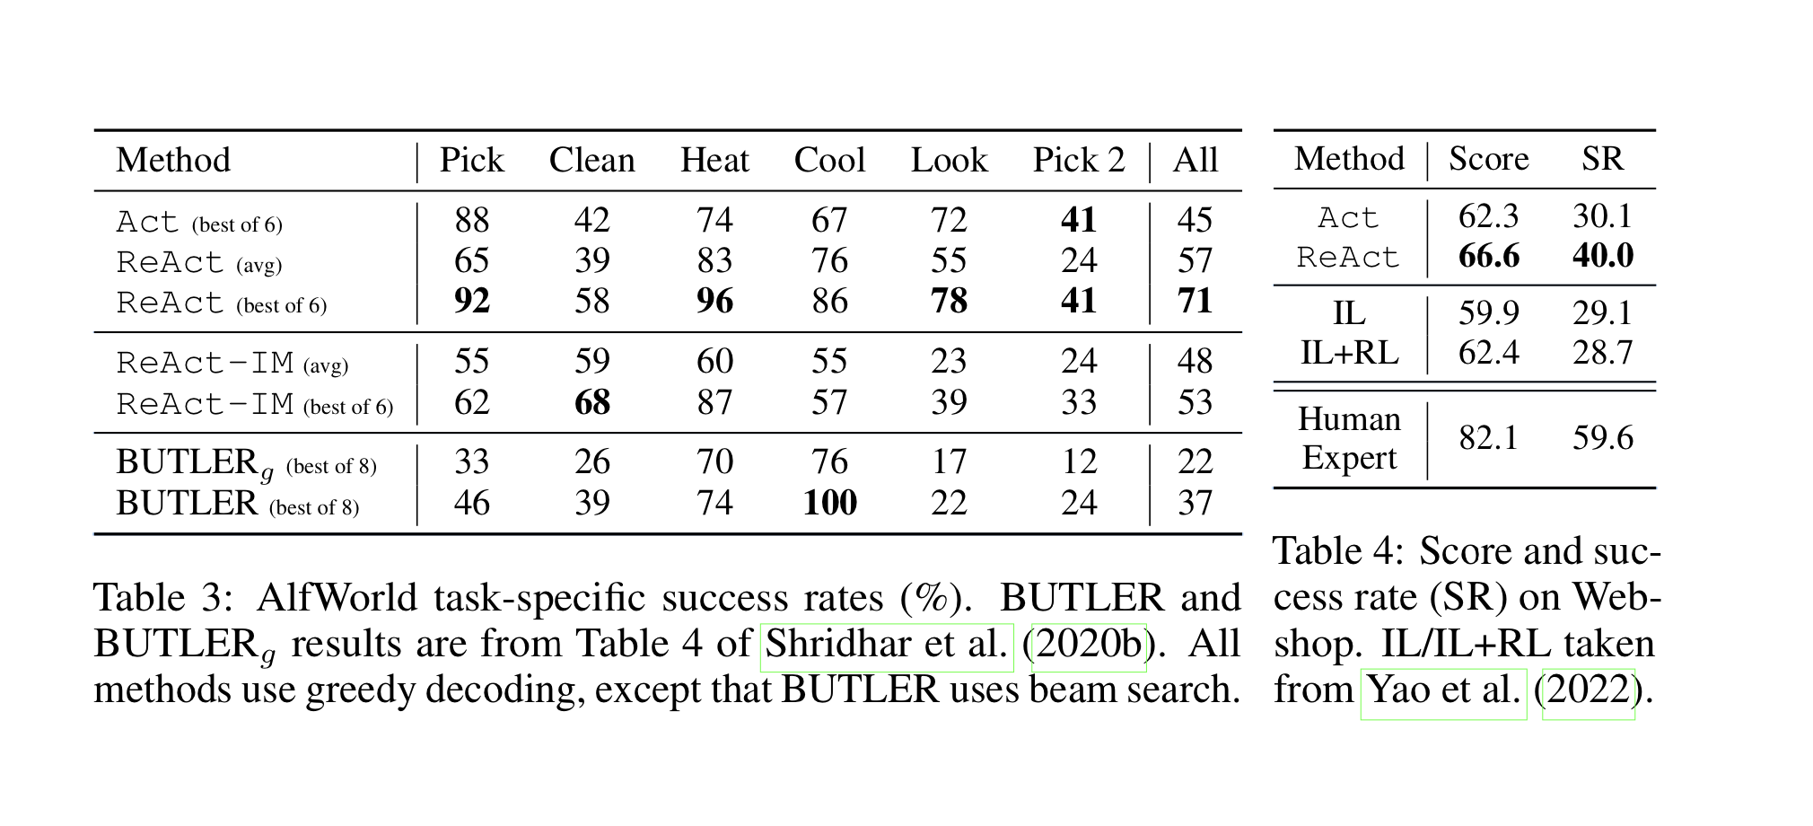
Results
React: Synergizing Reasoning And Acting In Language Models Shunyu Yao, Jeffrey Zhao , Dian Yu, Nan Du, Izhak Shafran, Karthik Narasimhan, Yuan Cao - Department of Computer Science, Princeton

Slide 53
Observations
ALFWorld
ReAct outperforms Act by utilizing reasoning for goal decomposition and tracking.
WebShop
ReAct significantly outperforms imitation learning (IL) methods by reasoning during web interactions, leading to better product selection and higher success rates On ALFWorld, the best ReAct trial achieves an average success rate of 71%, significantly outperforming the best Act (45%) and BUTLER (37%) trials
React: Synergizing Reasoning And Acting In Language Models Shunyu Yao, Jeffrey Zhao , Dian Yu, Nan Du, Izhak Shafran, Karthik Narasimhan, Yuan Cao - Department of Computer Science, Princeton

Slide 54
Related Work
Perhaps the closest prior work is Inner Monologue (IM), from Huang et al. (2022b), in which actions from an embodied agent are motivated by an eponymous “inner monologue”. However, IM’s “inner monologue” is limited to observations of the environment state and what needs to be completed by the agent for the goal to be satisfied
React: Synergizing Reasoning And Acting In Language Models Shunyu Yao, Jeffrey Zhao , Dian Yu, Nan Du, Izhak Shafran, Karthik Narasimhan, Yuan Cao - Department of Computer Science, Princeton

Slide 55

Illinois Blue

